Slide 1
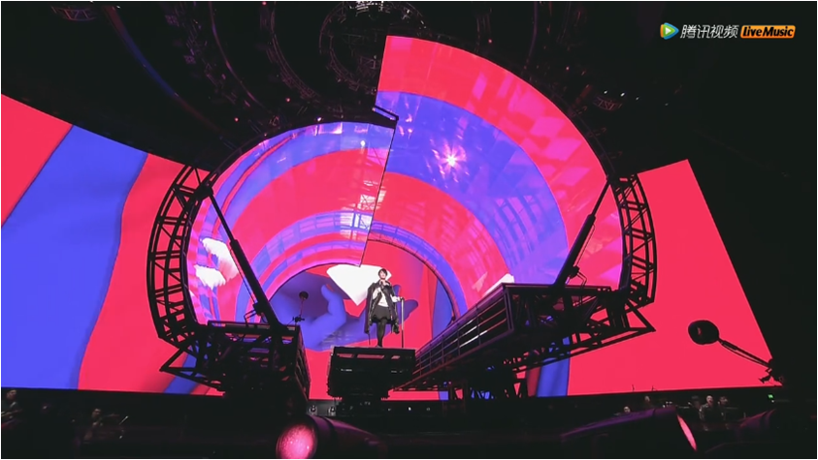
YIPLED · ICE SCREEN (RENTAL SCREEN)
Transparent Led Screen

Slide 2
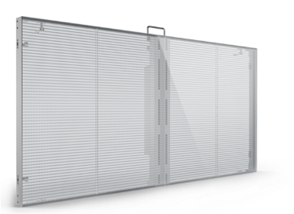
Product Description
Easy to install and disassemble
85% Transparency
Controlled by smart phone
Weight: only 16KG/m2
Thickness: only 38mm
Transparent LED rental screen is a new type of LED display with features like transparent display, easy to install and disassemble, smart control etc. A totally new, irreplaceable, creative application effect can be realized by using transparent led screen in concert, TV station’s party & large entertainment program, auto show & high-end exhibition, and large-scale new product launch conference etc. Transparent LED screen quickly becomes a big trend in the LED display rental market.

Slide 3
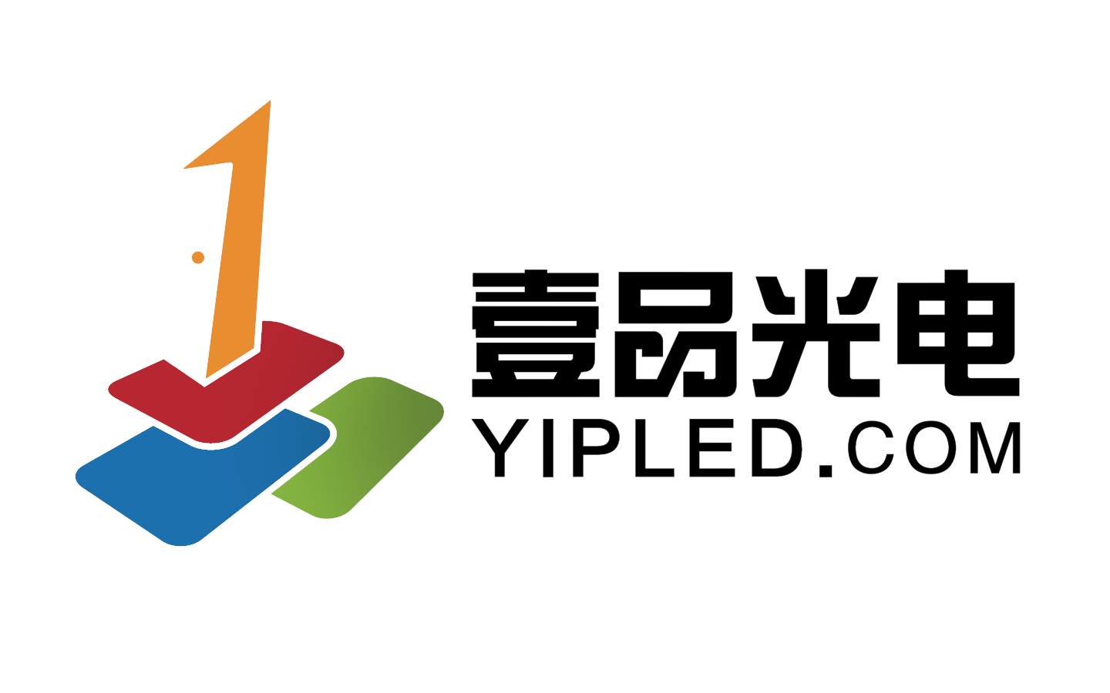
YIPLED · ICE SCREEN · TRANSPARENT LED RENTAL SCREEN

Slide 4
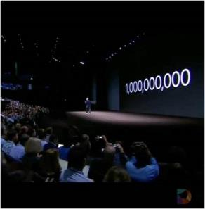
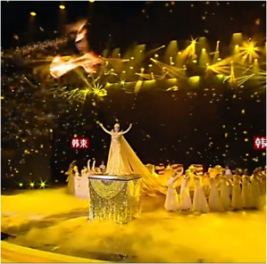
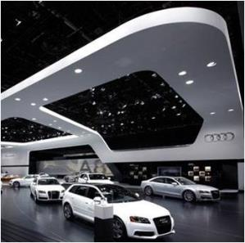
Applications
01
02
03
04
Concert
TV station’s party and large entertainment program
Auto show and high-end exhibition
Large-scale new product launch conference

Slide 5
01
Cases

Slide 6
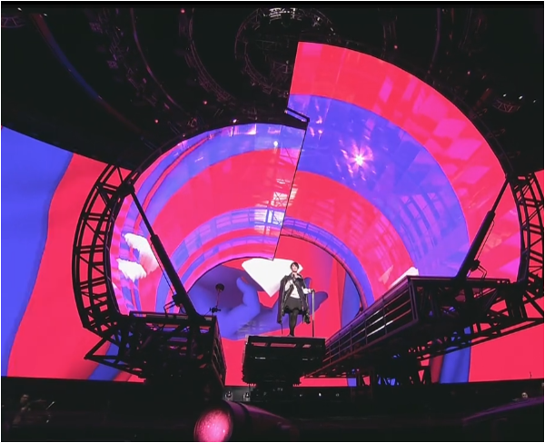
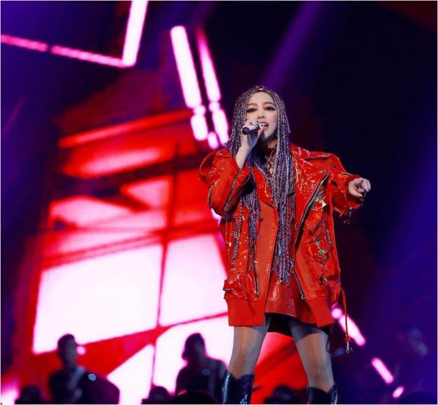
Faye’s Moments Live Concert 2016 / A Mei World Tour Concert 2017
Faye’s Moments Live Concert 2016
A Mei World Tour
Concert 2017

Slide 7
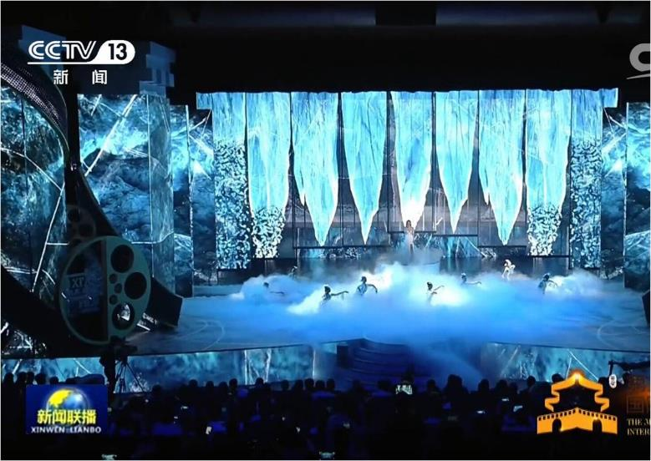
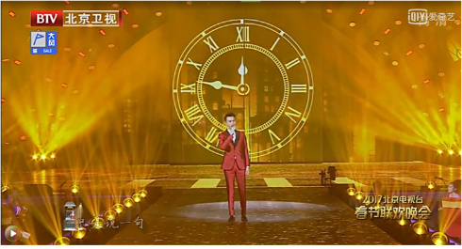
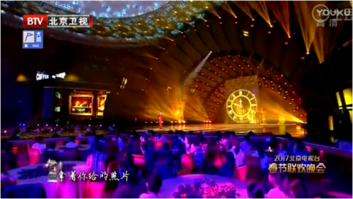
The 3rd Silk Road International Film Festival / 2017 BTV Spring Festival Gala Evening
The 3rd Silk Road International Film Festival
2017 BTV Spring Festival Gala Evening
2017 BTV Spring Festival Gala Evening

Slide 8
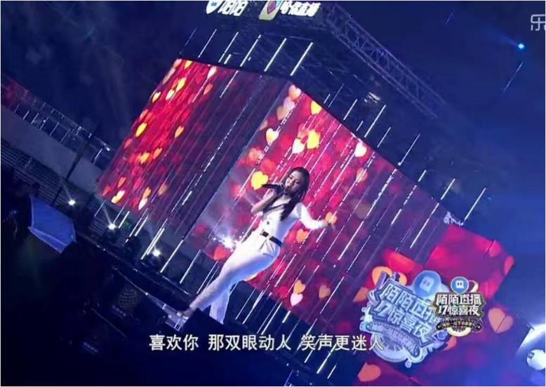
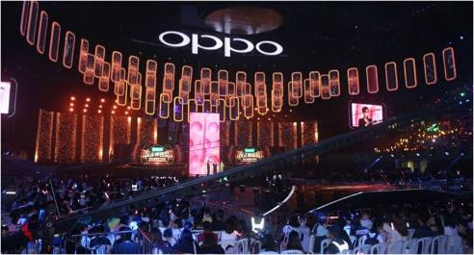
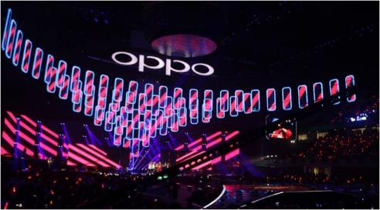
2017 “OPPOR11 New Product Launch Conference” Midyear Grand Ceremony
Momo Year-end Ceremony / 2017 “OPPOR11 New Product Launch Conference” Midyear Grand Ceremony
Momo Year-end Ceremony
2017 “OPPOR11 New Product Launch Conference” Midyear Grand Ceremony

Slide 9
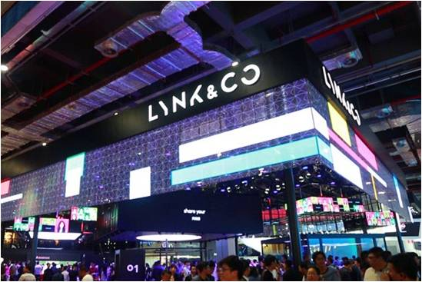
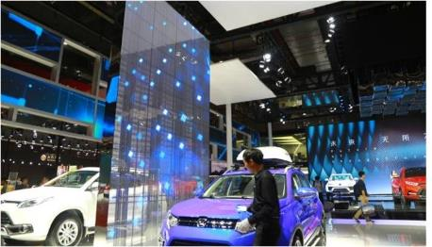
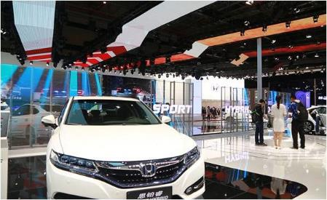
2017 Shanghai International Auto Show
2017 Shanghai International Auto Show - JMC
2017 Shanghai International Auto Show - LYNK&CO
2017 Shanghai International Auto Show - ·HONDA

Slide 10
02
Application Value

Slide 11
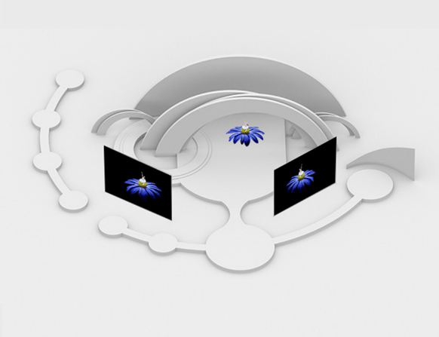
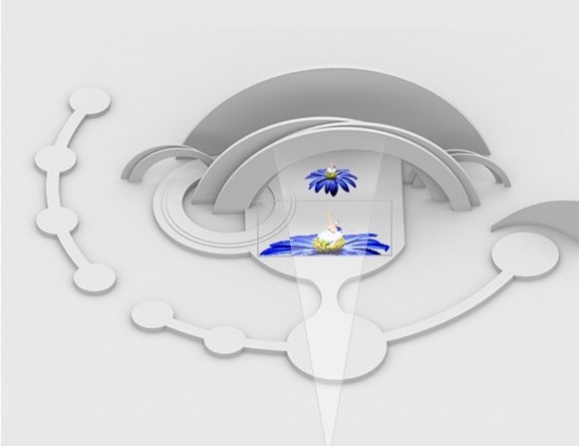
Transparent – there is no visual barrier in sense of space after using transparent LED screen.
Traditional
Transparent

Slide 12
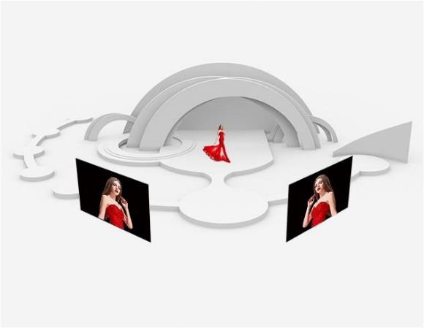
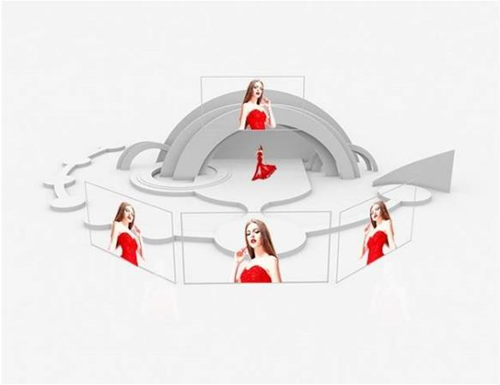
Transparent -- more flexibility in choosing the assemble position for the transparent LED screen.
传统
透明

Slide 13
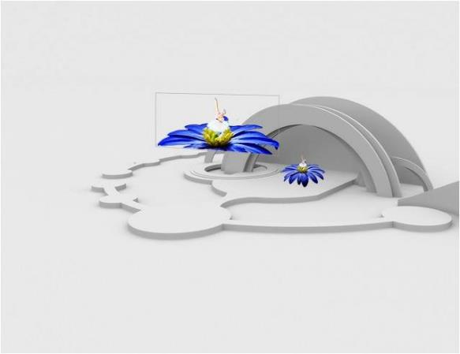
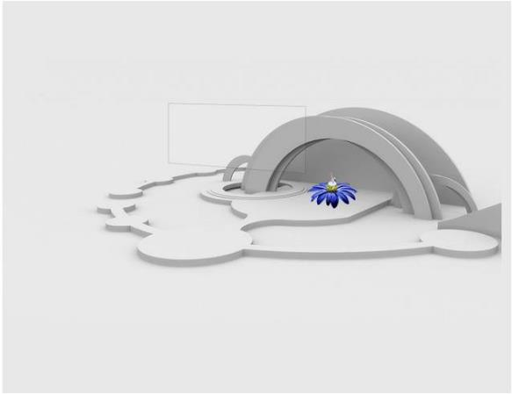
Transparent - a perfect combination of the transparent LED screen and the site environment
ON
OFF

Slide 14
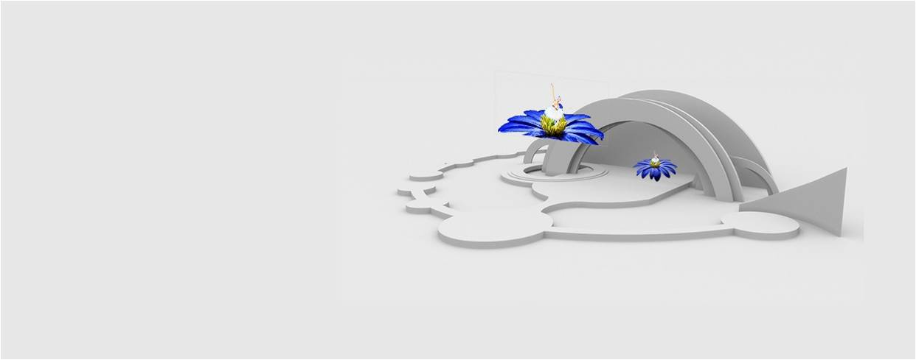
Creating stereoscopic images in the sky - the audience can't aware of the presence of the transparent LED screen because of the high transparency and far distance.

Slide 15
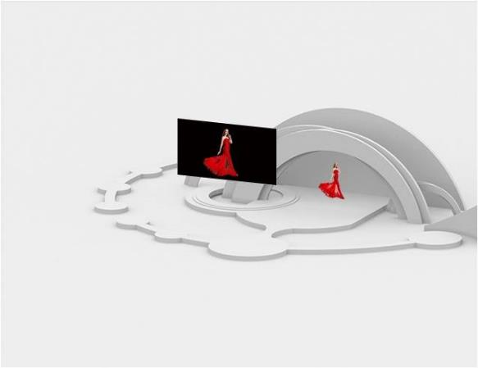
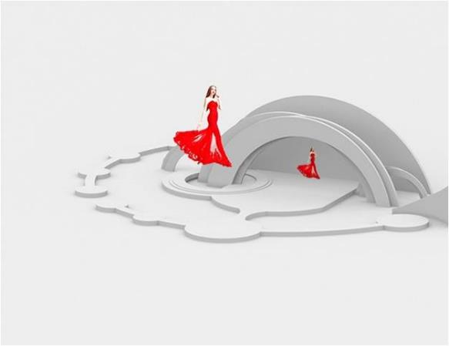
Creating stereoscopic images in the sky - when shown on the screen, those stereoscopic images look like appearing in the sky directly.
传统
透明

Slide 16
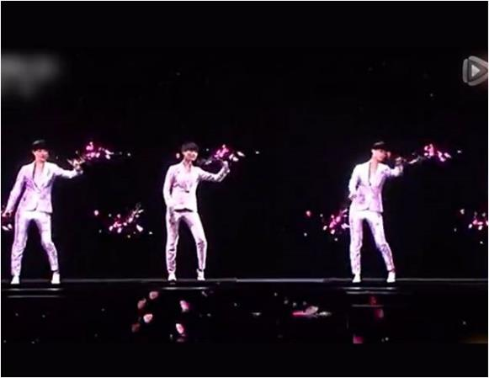
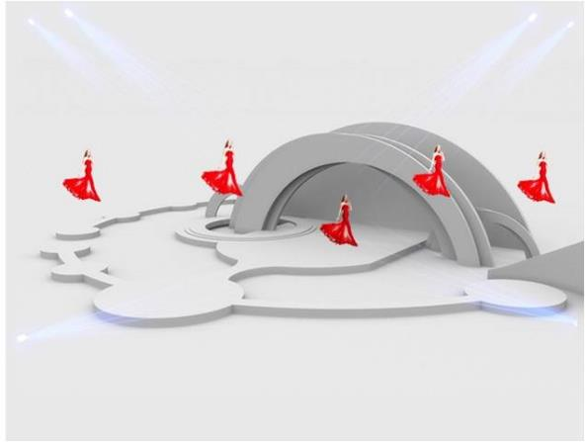
Creating stereoscopic images in the sky
Different from holographic images, transparent LED screen is suitable for all kinds of site environment, and won't be effected by the light of the environment.
holographic
transparent
_{Day / Night}

Slide 17
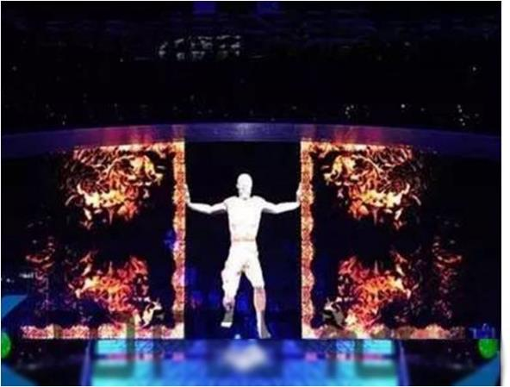
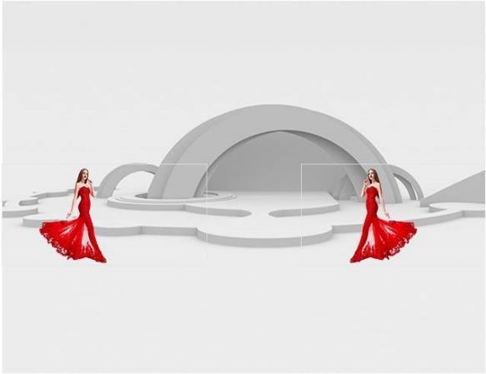
Coordinating with stage machinery，create dynamic scene of stereoscopic images
Can move to any direction without affecting stage design and without causing visual barrier

Slide 18
With no limitation for creativity in image scene, transparent LED screen becomes a trend for industry application - Transparent LED screen let wonderful creative ideas come true.

Slide 19
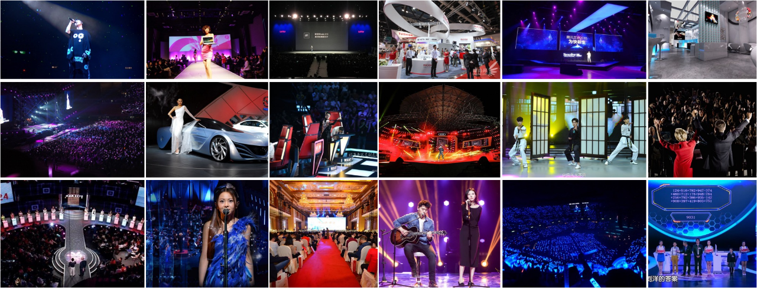
With no limitation for creativity in image scene, transparent LED screen becomes a trend for industry application -The demand of transparent LED screen definitely will be a big trend in LED screen rental market.

Slide 20
03
Technology Advantage

Slide 21
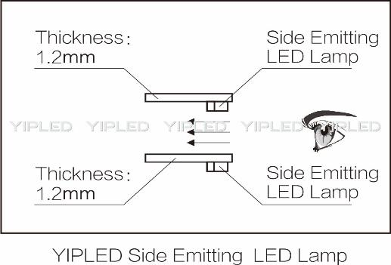
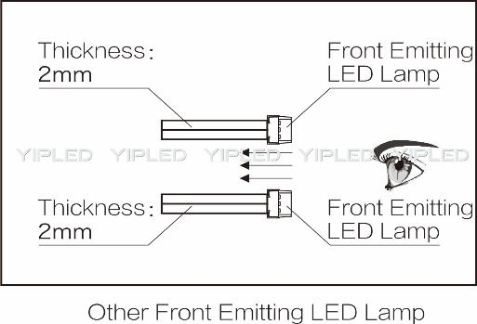
Side Emitting, the best solution for transparent LED rental screen
VS

Slide 22
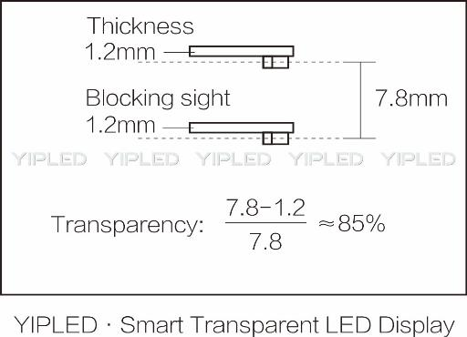
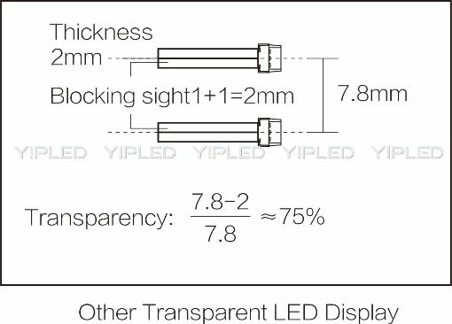
Side Emitting, only screen with over 85% transparency is the real transparent LED screen
VS

Slide 23
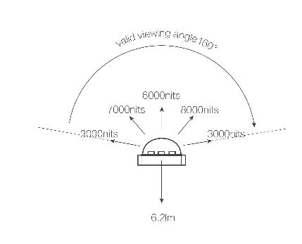
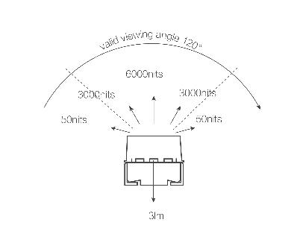
Side Emitting, viewing angle 160°, all the audience can be covered
VS
YIPLED Side Emitting Solution
Other Front Emitting Solution

Slide 24
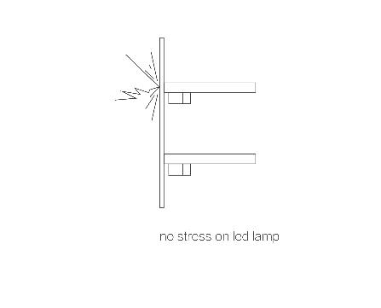
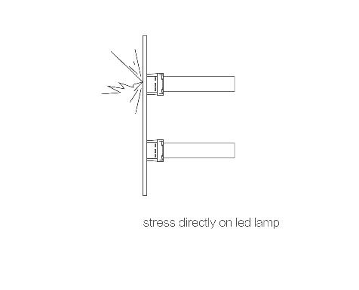
Side Emitting, born for rental, no lamp damages even after frequent installation and uninstallation
VS
YIPLED Side Emitting Solution
Other Front Emitting Solution

Slide 25
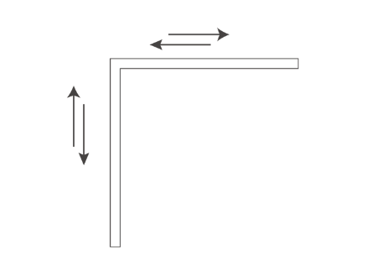
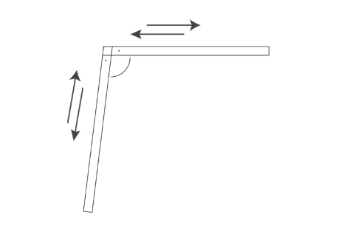
Die casting aluminum structure will not be deformed even after frequent installation and uninstallation
VS
YIPLED Die Casting Aluminum Structure Solution
Other Structure Solution

Slide 26
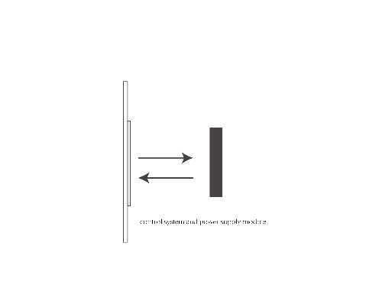
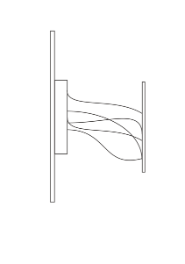
Integration of control system and power supply into one module, easy and fast installation, uninstallation and maintenance
VS
YIPLED Side Emitting Solution
Other Front Emitting Solution

Slide 27
On-site Operation Experience Report
1.Side emitting, look up viewing angle is better without blocking by lamp strip.
2.Light can penetrate without affecting stage lighting effect.
3.8 pin cable – no screen flash affected by audio vibration.
4.SMD on surface of the bar – avoid the led lamps being knocked off
5.Different batches, not too much visual difference, can be put around the main screen.
6.Main controller has good compatibility, on-site system is stable
（CCTV-1 "Artificial Intelligence is Smarter than Human" , International Film Festival, Faye’s Wong’s Concert, Zhang Hui Mei ‘s Concert, 2017 BTV Spring Festival Gala Evening, International Auto Show etc）
7. The power supple (including FPC) + receiving card can be dissembled as a whole, if any problem, quick maintenance is possible.
8.Wide viewing angle, small brightness consumption within 160º angle.

Slide 28
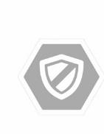
Customer Service
Respond to customers in one hour, try to solve the problem in 48 hours
Provide technical support if necessary for big events to make sure the screens are working perfectly
Periodically do quality inspection and maintenance, and ask for customer opinion to improve

Slide 29
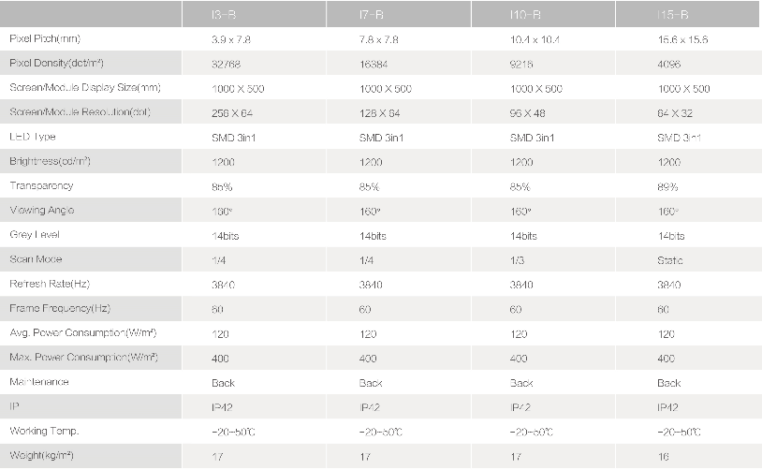
Specification

Slide 30
SHENZHEN YIPLED CO., LTD
Address: 9th Floor, Building A, Block 5#, Skyworth Inno Valley, No.8 Tangtou 1st Road, Shiyan, Bao’an District, Shenzhen, P. R. China
Phone：0755-86325219 Email：sales@yipled.com
Chinese Website：www.yipled.cn English Website：www.yipled.com

